Slide 1
T1A3 Terminal App
BY: JAN MARVIN CONSUL
Notes:
Hi,
Welcome to my little bit of presentation. Thank you for having me here.
Let me begin right away as I know your time is precious.

Slide 2
Terminal Application
Notes:
So, what will we talk about today?
Read everything

Slide 3
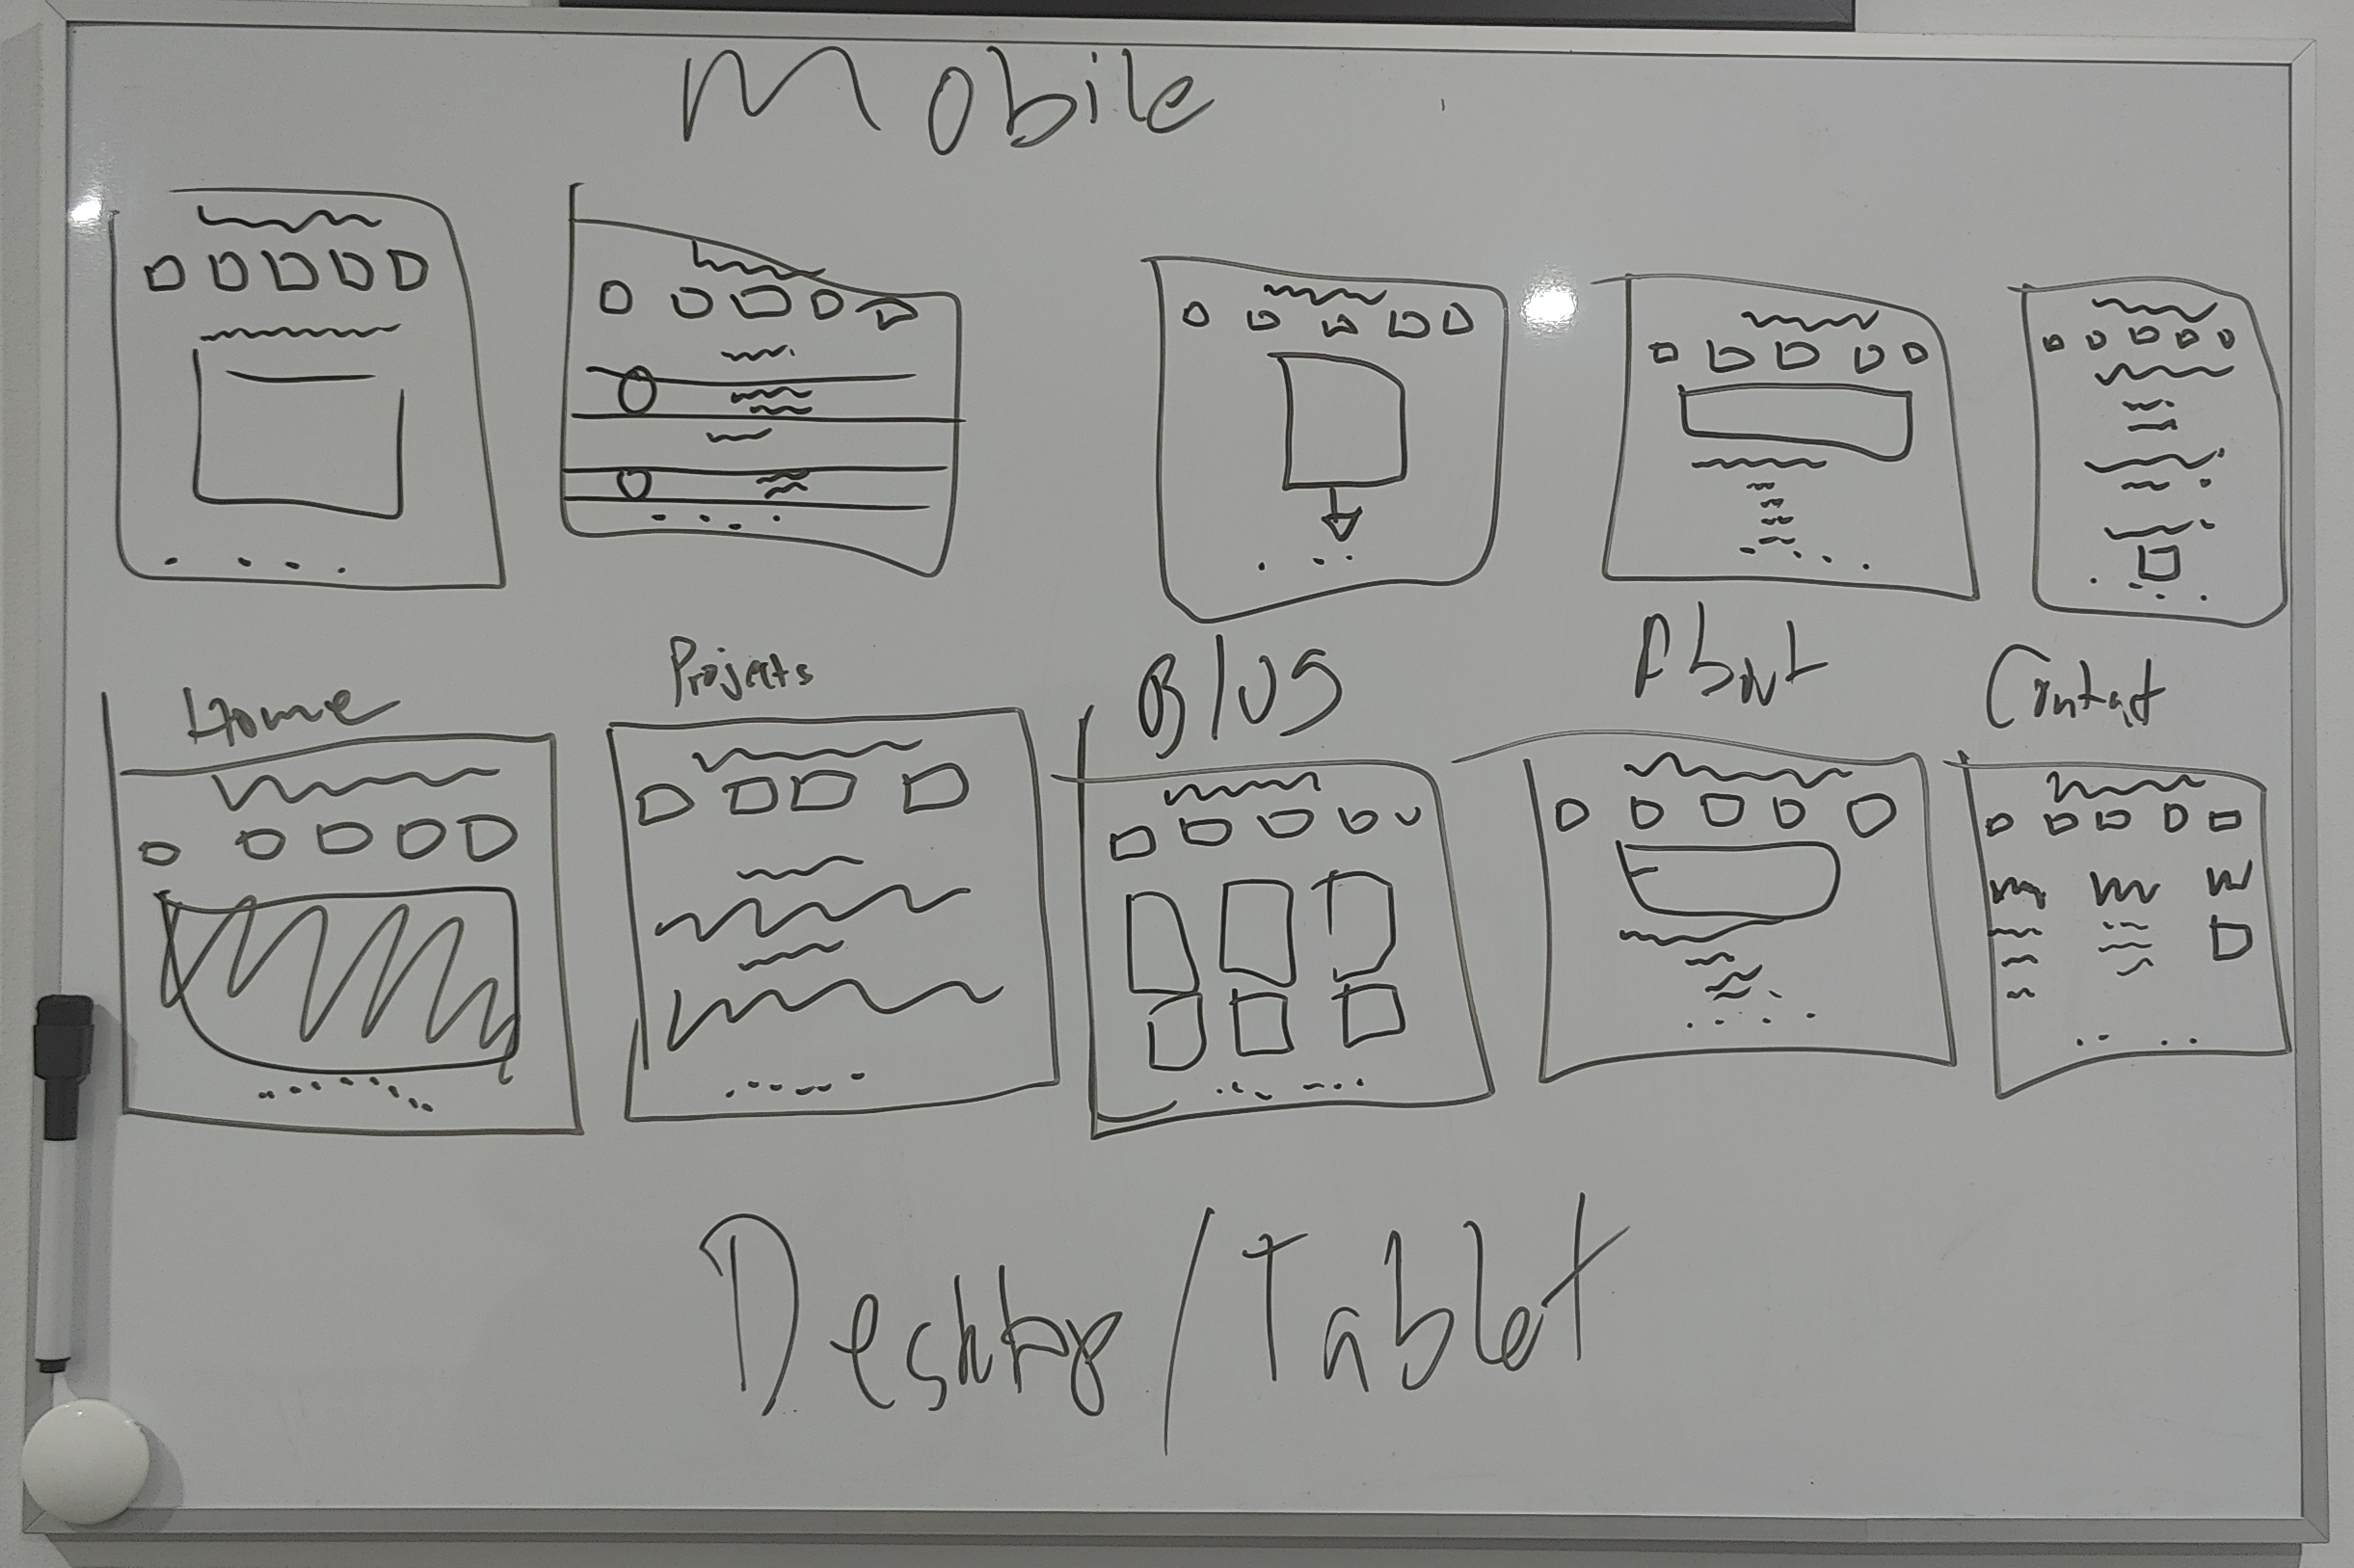
Wireframe
Here’s my Wireframe – I could have done it in Figma but I didn’t like having to add another thing on the list of stuff I need to alt-tab to so I wrote it on the whiteboard above my screen. (or at least attempted to)
Notes:
So, what will we talk about today?
Read everything

Slide 4
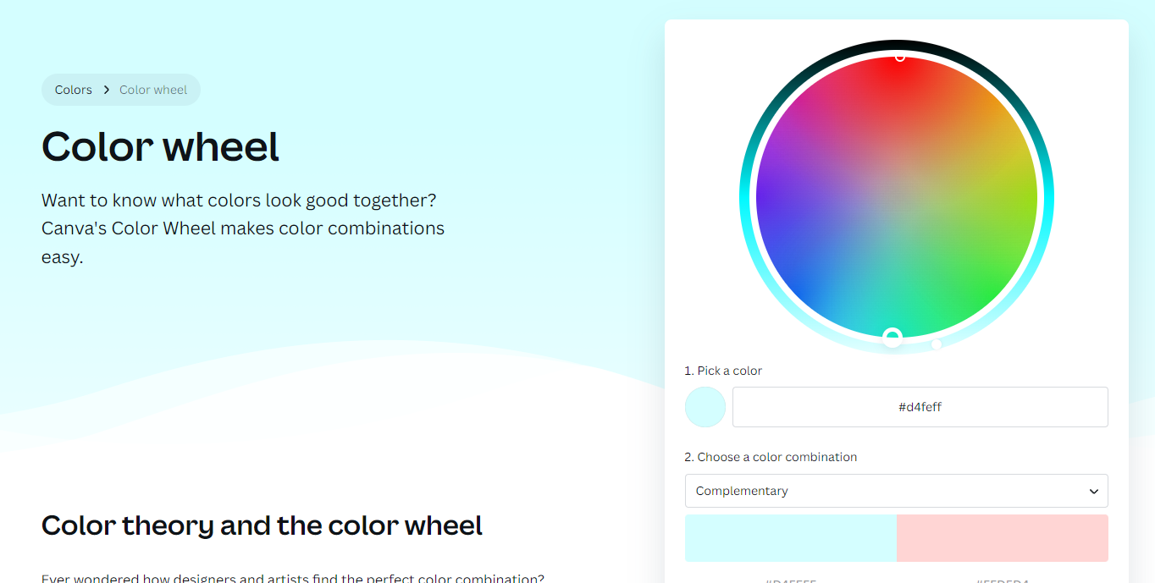

Color Schemes and Favicon
I’d like to site what I used for the favicon but I couldn’t locate it anymore.
I used Canva’s Color wheel microsite. It’s actually pretty cool.
Notes:
So, what will we talk about today?
Read everything

Slide 5
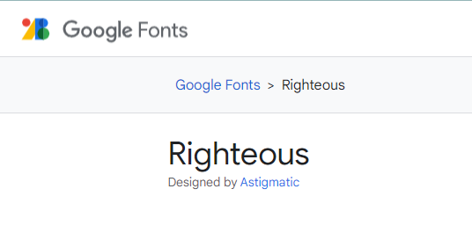
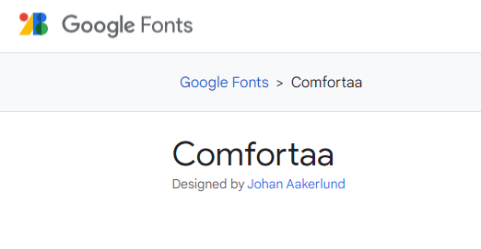
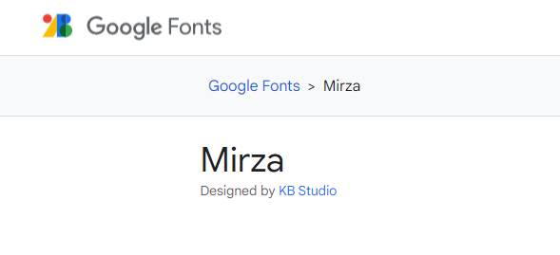
Fonts
Okay so I browsed through Google fonts to find these. Initially I thought only one font would suffice (Righteous. Because it’s righteous and it has more rounded letters). Then it looked weird so I added another (Comfortaa. No reason I just felt it mixed well with Righteous). Then I noticed the nav text was hard to read on mobile with the chosen fonts so I looked for one that is compact and readable so it doesn’t mess with the nav box sizes so we got Mirza here to save the day.
Notes:
So, what will we talk about today?
Read everything

Slide 6
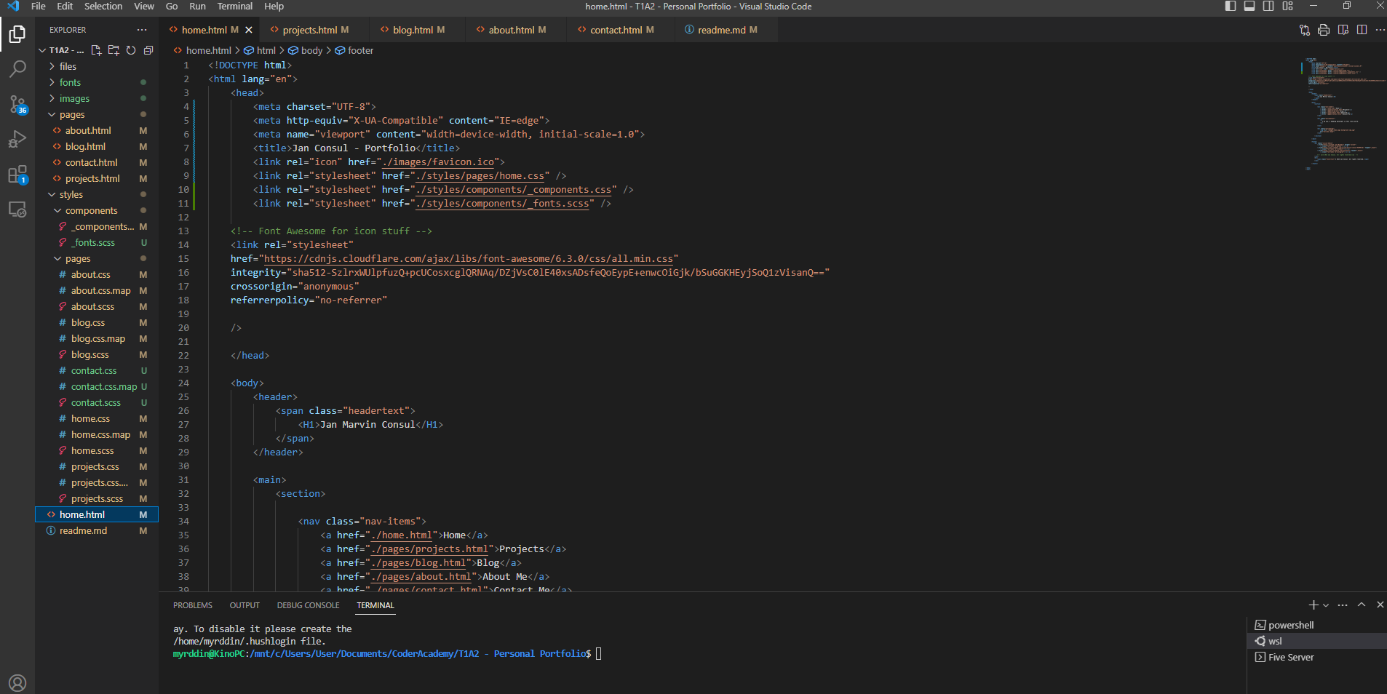
Platform used
Everything was done through VS Code
Notes:
So, what will we talk about today?
Read everything

Slide 7
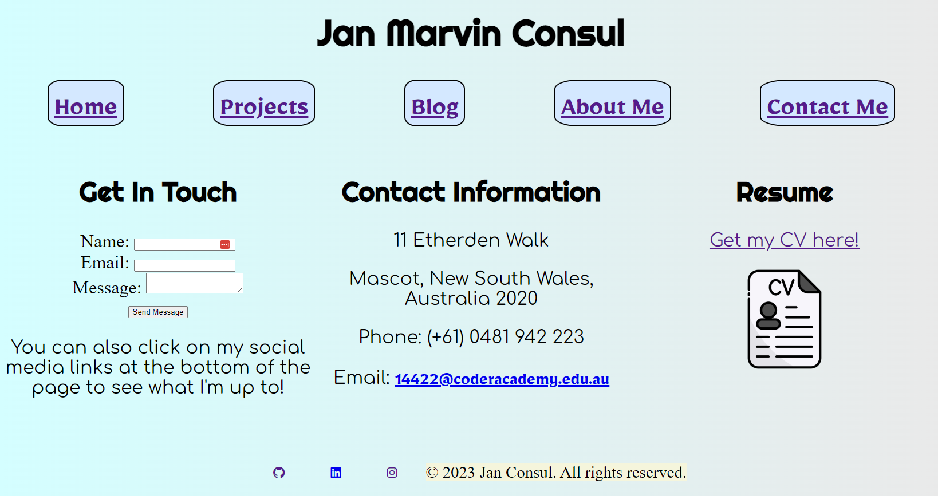









Components
Header
Nav
Body
Footer
Okay so basically only 4 components. The header, Nav, Body, and Footer.
I think the components are pretty simple, so the styling kind of does the work in terms of engagement. Every page I tried to add something quirky in it. For example, the changing image depending on the size for homepage. Or the CV download function.
Notes:
So, what will we talk about today?
Read everything

Slide 8
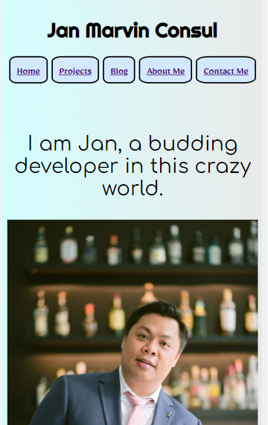
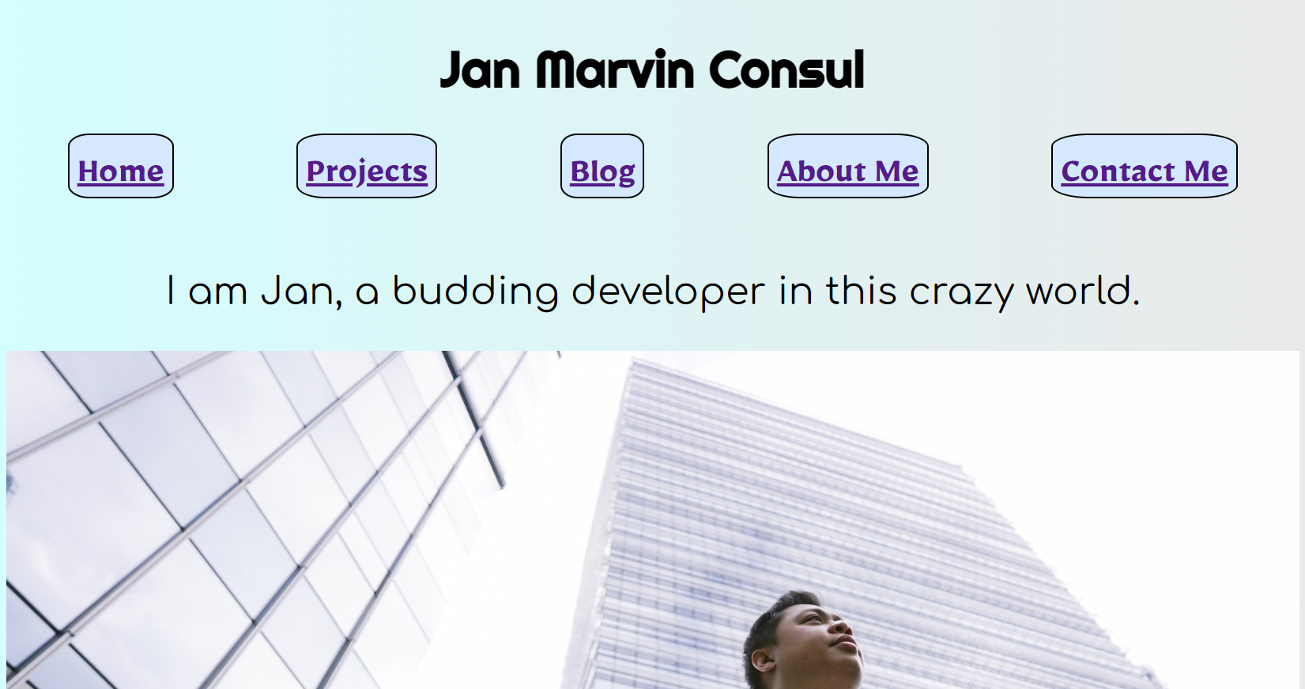
Homepage
Nothing revolutionary here. Just a basic home page. However, if viewed on a smaller screen like a mobile, it will change an image. *very interactive*
I chatted with a professional about it and he loathes the decision of two different images but I just opted to go ahead because there’s a kind of “surprise” with a different image.
Notes:
So, what will we talk about today?
Read everything

Slide 9
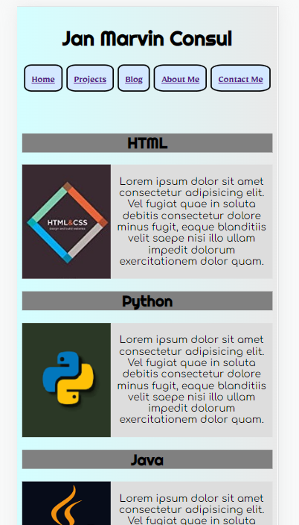
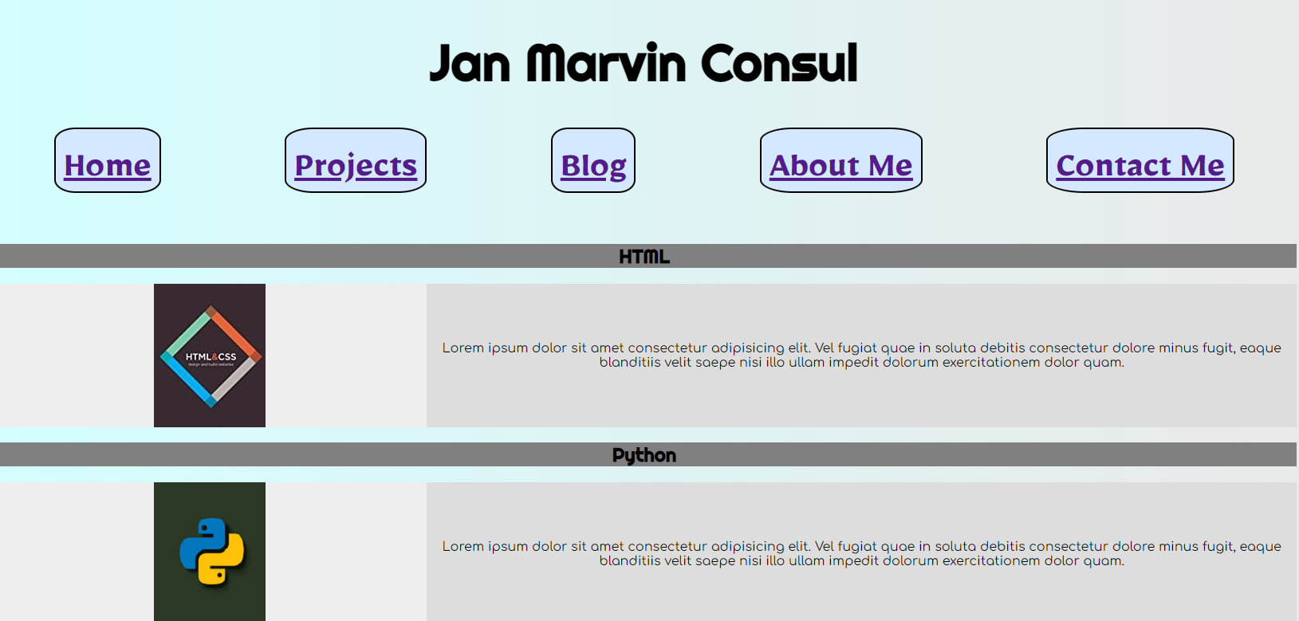
Projects
So for projects, I found it cool to have a different section or an additional section to the site. So I pretended to have projects with different languages in here. This is also a trial of using a grid instead of flexbox with different fr’s.
I kinda liked having the bg color on the image, aesthetically for me it kind of flowed in as it was a neutral color and it helped to not make the page look very monotonous with the additional colors.
Notes:
So, what will we talk about today?
Read everything

Slide 10
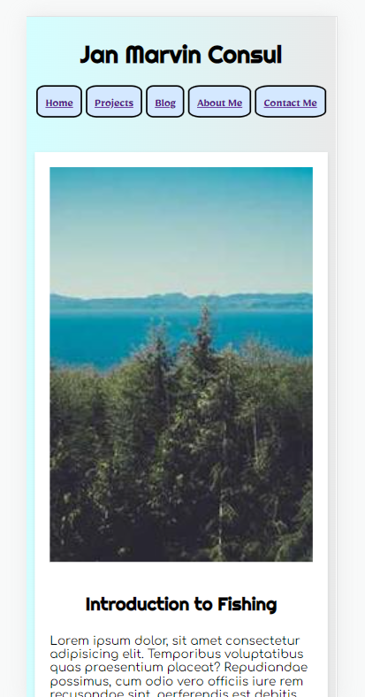
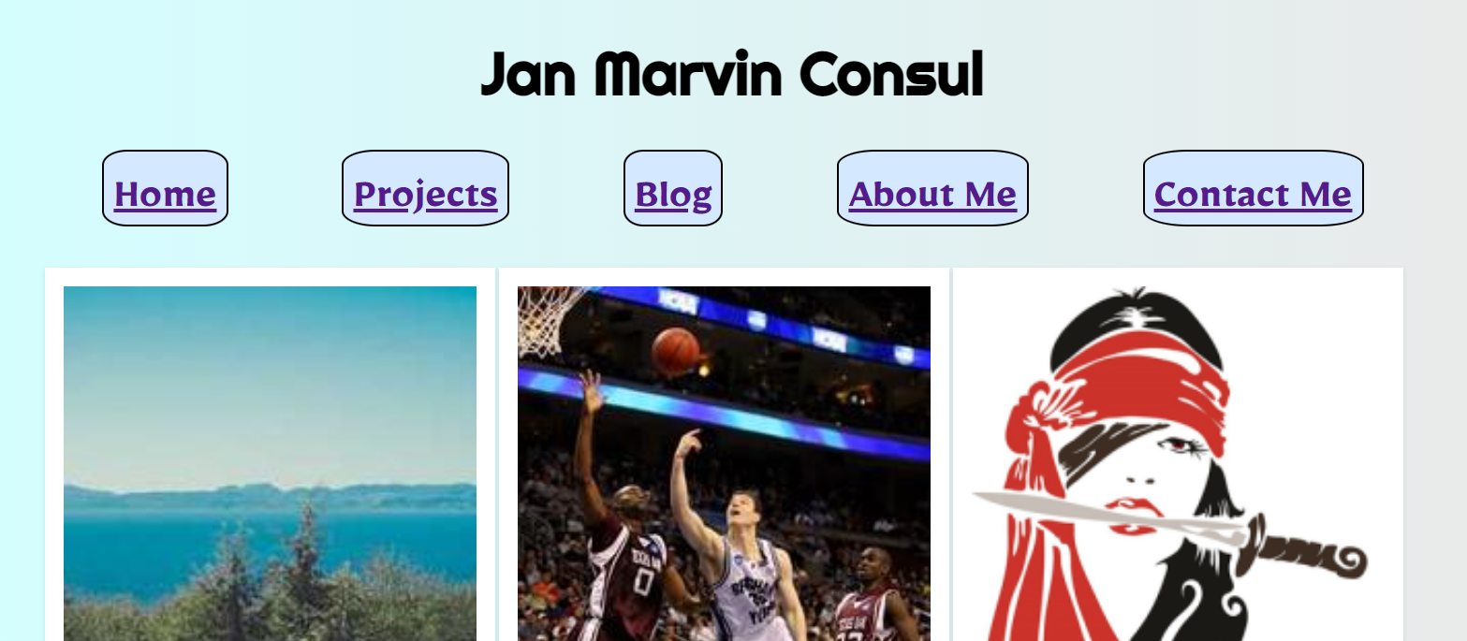
Blog
I couldn’t really think of what to add here so I just mashed together a couple different topics of my interest. Those would actually be listed in my about me page.
So what’s kinda fresh in this page is that the images are taken online instead of housed in the zip like the other images. So you’d need an online connection in order to view the images.
Notes:
So, what will we talk about today?
Read everything

Slide 11
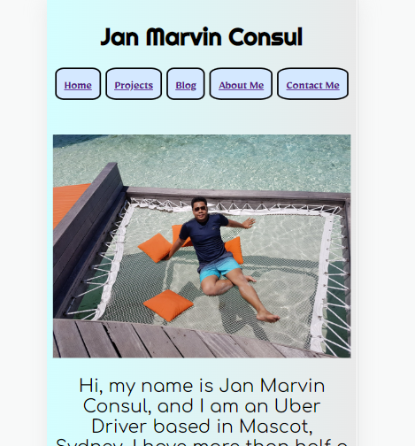
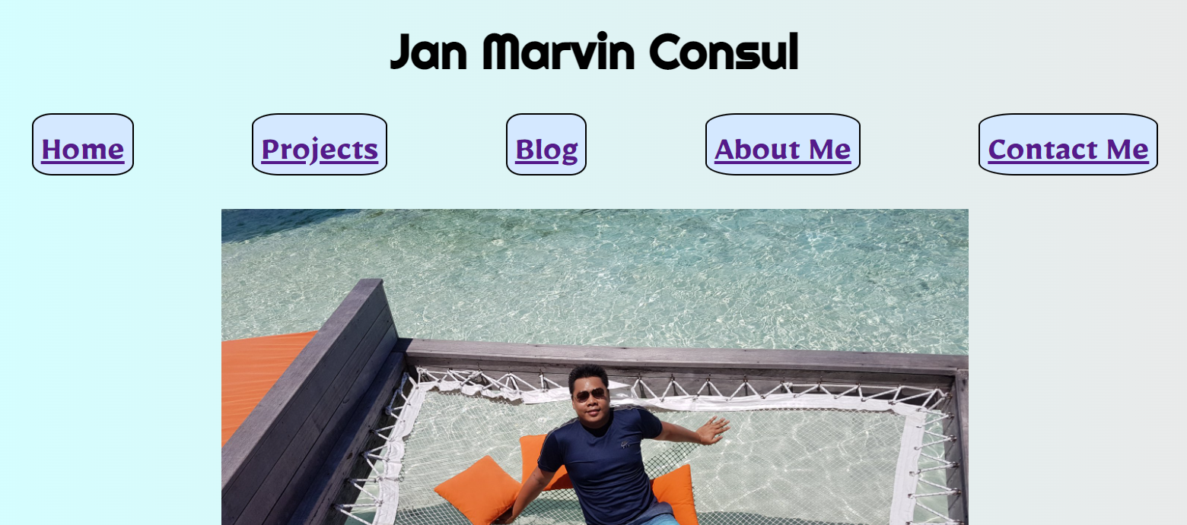
About Me
Yeah so this was initially my homepage image. But then decided to just move it to the about me page since it was more casual. I was thinking of removing the dots in the unordered list as well but it would be additional work to align the texts and the ul style doesn’t really look bad with the font I chose.
Notes:
So, what will we talk about today?
Read everything

Slide 12
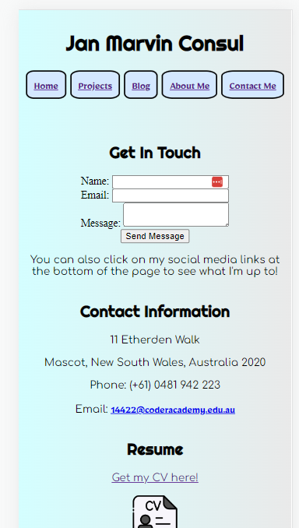
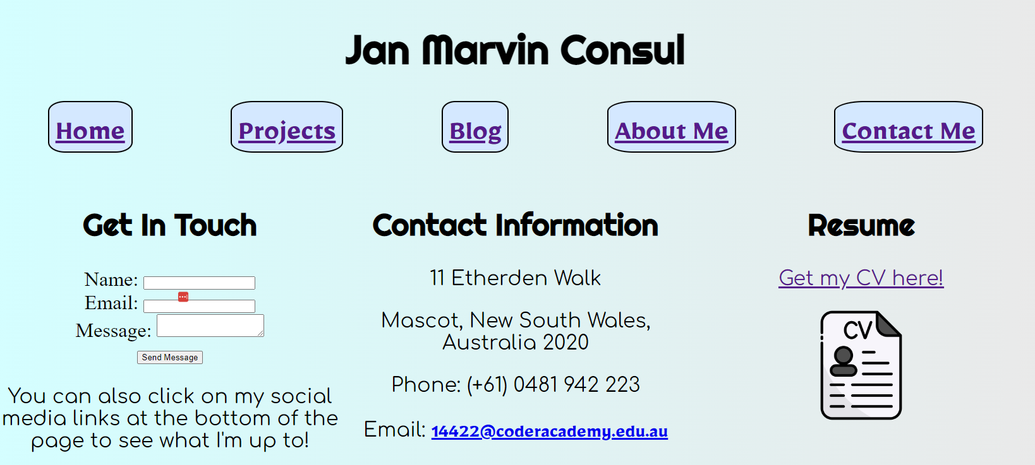
Contact Me
Okay so this one is actually my favorite child. (Please ignore the last pass icons thanks).
I like this particularly because I felt like I executed the grid properly here and I assigned each div into a different grid. It looks pretty as well. Also, there’s something different about this one. If you click on “Get my CV here!”, it would prompt a download of the CV. However, if you clicked on the image, it would open the CV in another tab. Wooo!
Notes:
So, what will we talk about today?
Read everything

Slide 13
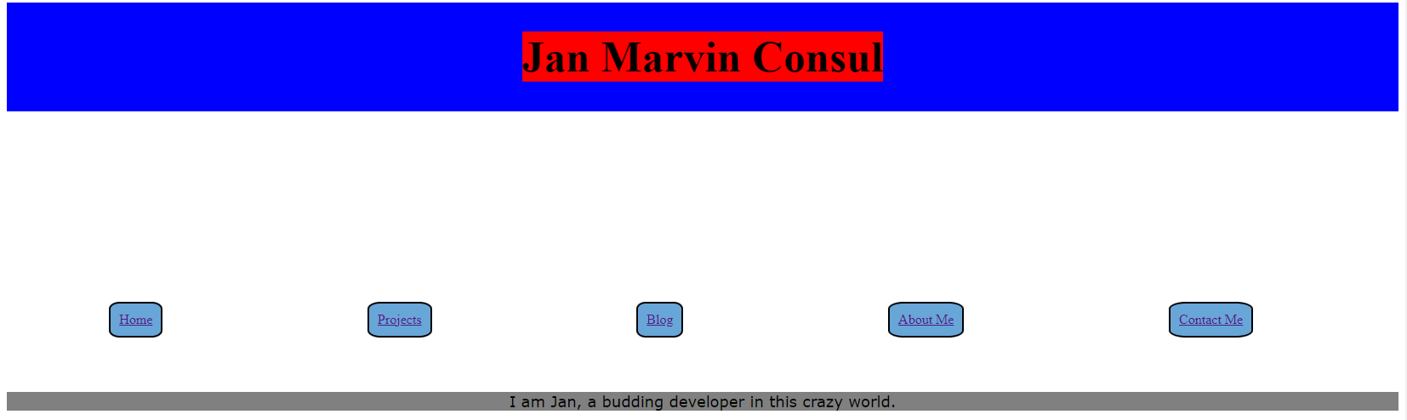
Previous version
This is a snippet of what it looked like before I finished. The different parts have colors so that I know where I need to change the code.
Notes:
So, what will we talk about today?
Read everything

Slide 14
Special Thanks

